Slide 1
Sarcasm Detection In Reddit
By: Shubham Kundu

Slide 2

Business PROBLEM
Detecting sarcasm is crucial for accurate sentiment analysis in various fields, including customer feedback, public relations, brand management, social media monitoring, and ad campaign analysis. Misinterpreting sarcastic comments can lead to flawed insights and responses, adversely affecting businesses. This project aims to develop a model capable of accurately identifying and understanding sarcasm in textual data to improve sentiment analysis and decision-making processes.

Slide 3
DEFINITION AND OBJECTIVE
Sarcasm: A nuanced form of sentiment where positive or intensified language is used to convey a negative or contrary meaning, which we can see hoards of, especially on Social Media.
Challenge: Interpreting sarcasm accurately is particularly difficult in the fields of Natural Language Processing (NLP) and sentiment analysis due to its subtle and context-dependent nature.
Objective: Develop a model capable of identifying and comprehending sarcastic expressions and patterns within textual data, using datasets from Reddit.

Slide 4
SOLUTION
Data Preparation:Load kaggle_train.csv and fill missing 'comment' values.Sample 10,000 records for efficiency.
Encode labels using LabelEncoder.
Text Vectorization:Use TF-IDF vectorizer with 5,000 features.Balance frequent and rare word importance.
Train-Test Split:Split data: 80% training, 20% testing.Use 20% of training data for validation.
Model Construction:Build a CNN with Conv1D, GlobalMaxPooling1D, Dense, Dropout, and BatchNormalization layers.Use ReLU activation for hidden layers, sigmoid for the output.
Compile with Adam optimizer and binary cross-entropy loss.
Training and Evaluation: Train with early stopping and learning rate scheduler over 50 epochs.
Evaluate using F1 score, accuracy, classification report, and confusion matrix.Save the model and TF-IDF vectorizer for future use.

Slide 5
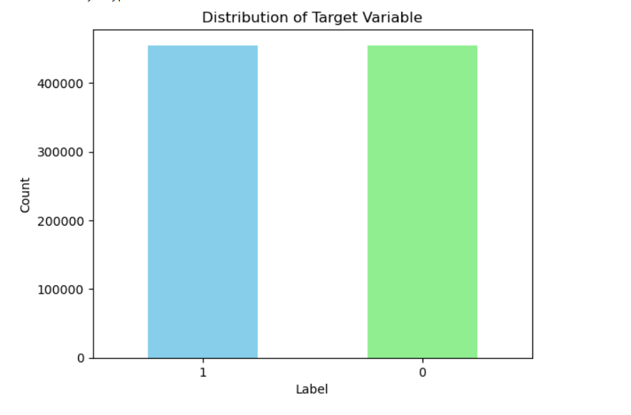
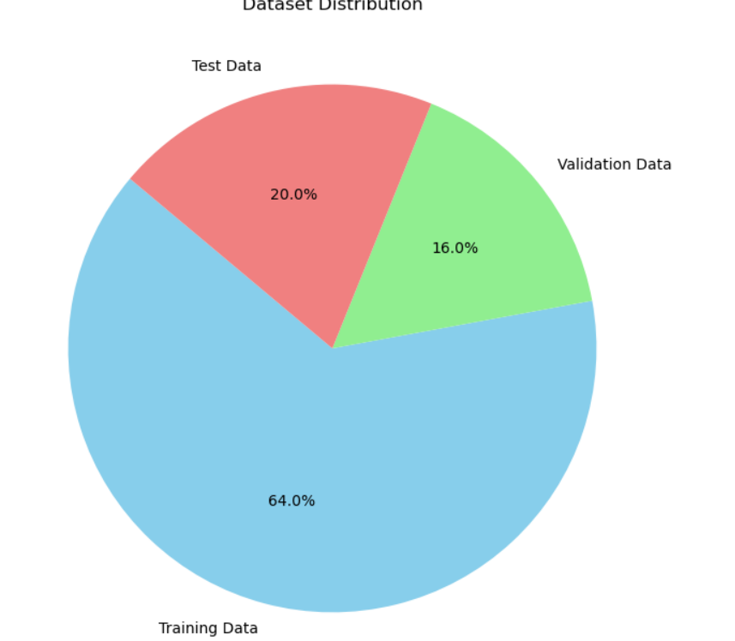
DATASET VISUALISATION

Slide 6
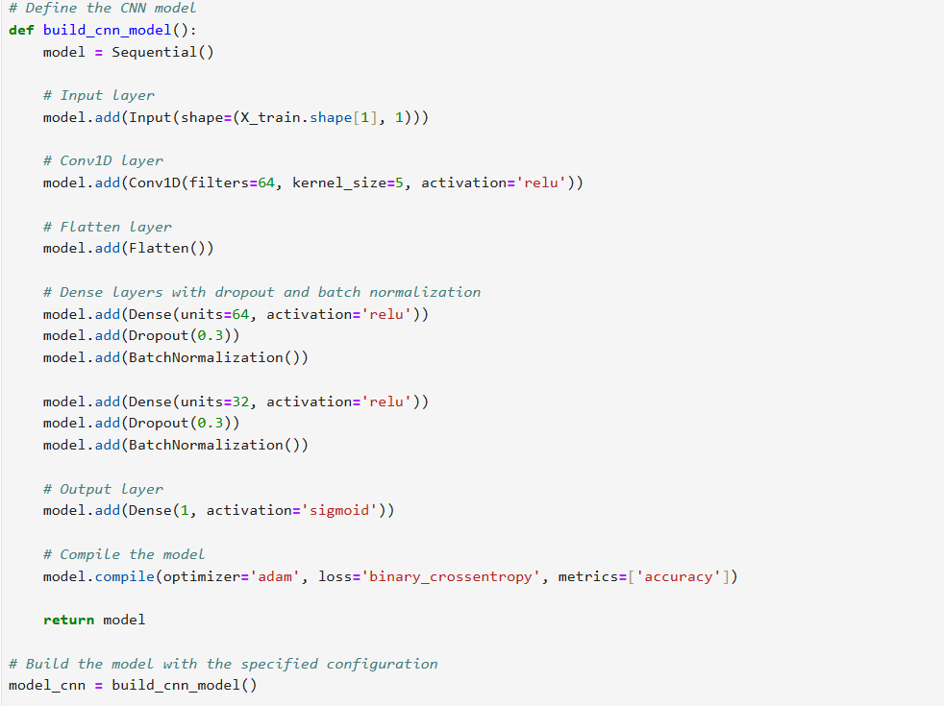
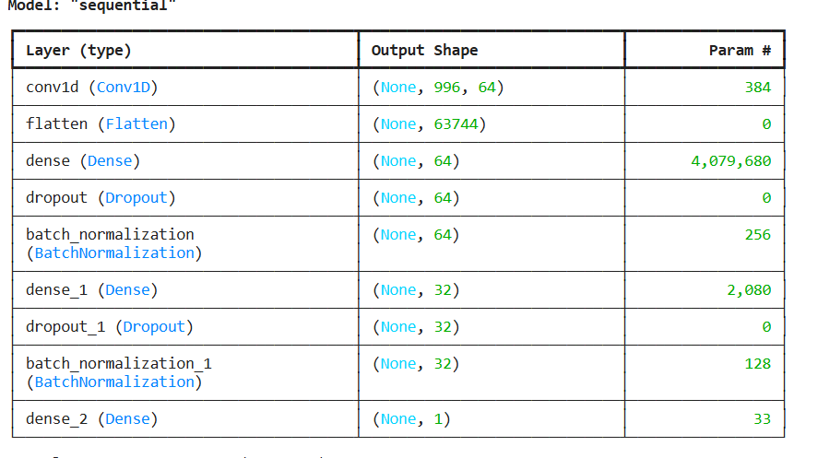
MODEL ARCHITECTURE
Model Architecture: Built a Convolutional Neural Network (CNN) using the Sequential model. The architecture included an input layer, Conv1D layers with ReLU activation, GlobalMaxPooling1D layer, dense layers with dropout and batch normalization, and a sigmoid output layer for binary classification.
Compilation: Compiled the model with the Adam optimizer, binary cross-entropy loss, and accuracy metric to configure it for training.

Slide 7
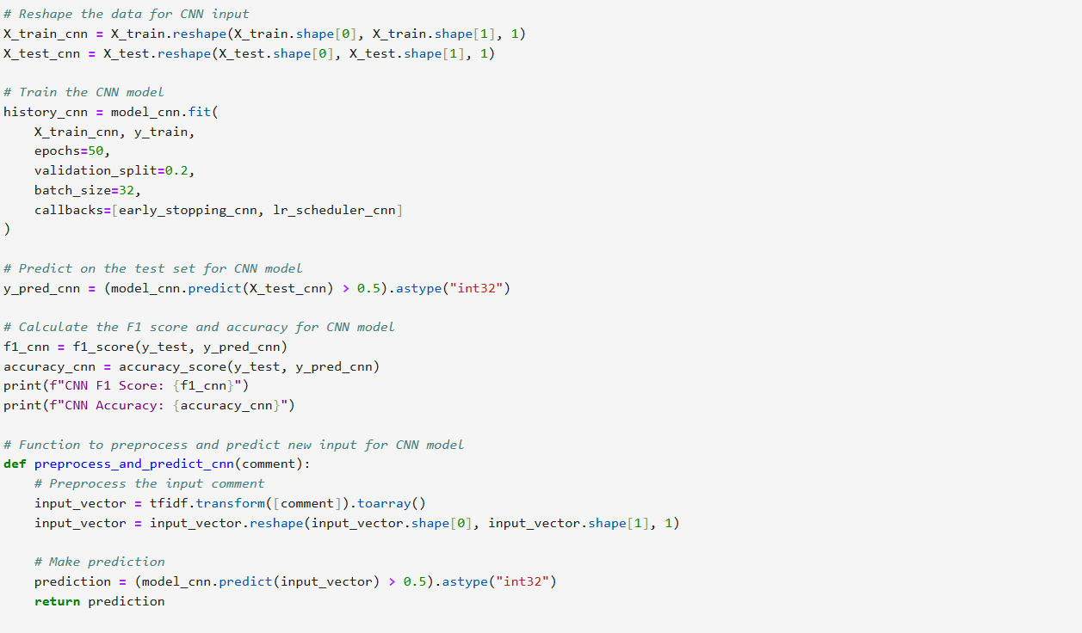
Training the Model
Handling Class Imbalance: Calculated class weights to address the imbalance between sarcastic and non-sarcastic comments.
Training Process: Trained the model for 50 epochs with early stopping (patience of 10 epochs) and a learning rate scheduler to prevent overfitting and improve convergence. Used a batch size of 128 to process more samples in parallel, speeding up the training process.
Model Evaluation: Evaluated the model’s performance on the test set using F1 score and accuracy metrics. Generated a classification report and confusion matrix to provide detailed insights into the model's performance.

Slide 8
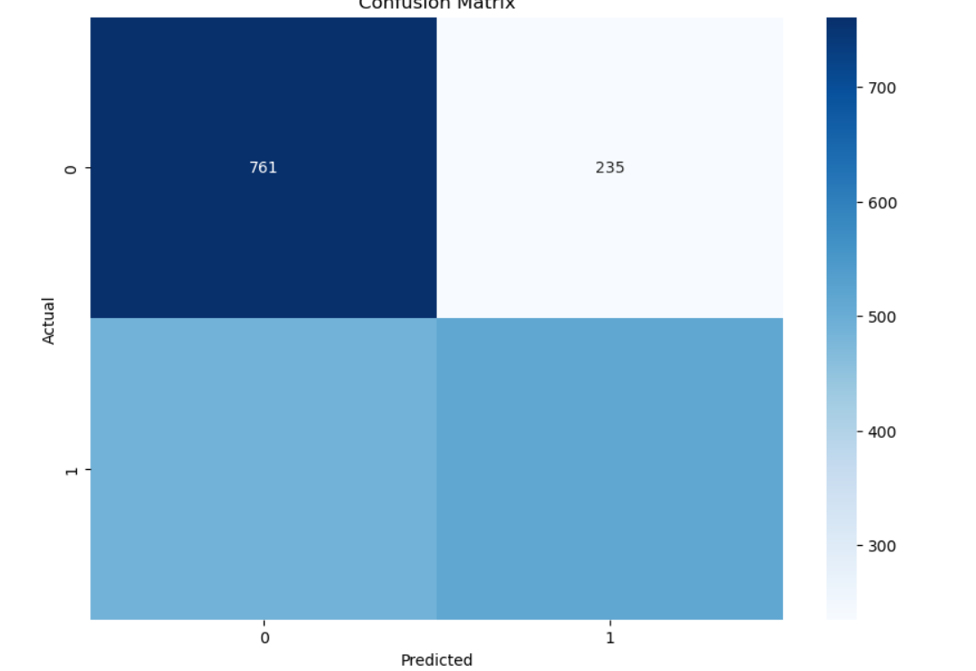
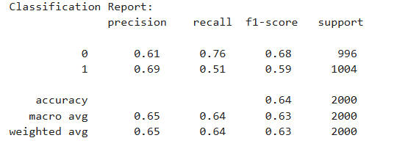
CLASSIFICATION REPORT AND CONFUSION MATRIX
Classification Report: Provided precision, recall, and F1 score for each class, offering a comprehensive view of the model's performance.Confusion Matrix: Visualized true positives, true negatives, false positives, and false negatives to identify specific areas of underperformance. Explained the importance of accurately detecting sarcasm in business applications and discussed future improvements like exploring other models, increasing dataset size, and further hyperparameter tuning.

Slide 9
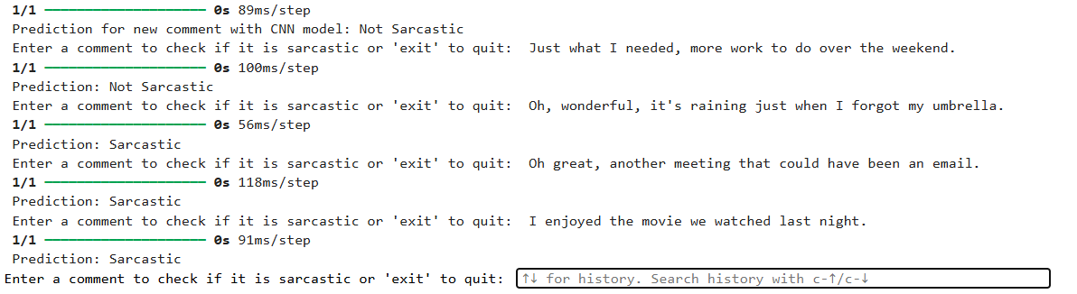
RESULT:
After entering text, here are the results

